Slide 1
Covid-Ninja
Our Team :
An AR Corona Game
R.Rohith Kumar,
3rd Year - B.Tech - Computer Science and Engineering,
SASTRA Deemed to be University.
S. Haridharan,
1st Year - B.Tech - Mechanical Engineering, SASTRA Deemed to be University.

Slide 2
Our Problem Statement:
Covid Augmented Reality Game
An Outline of our Idea :
To Create a Instagram and Facebook Platform based Augmented Reality Game Filter.
The user will be able to play the game with his/her
Eye Blink and the Score keeps increasing. Also, the game is made in such a way that it is a Informative one to the User.

Slide 3
Why Instagram and Facebook based AR Game Filter ?
Why not a dedicated AR App ??
Instagram sees over One Billion active monthly users
and 500 million daily Instagram Stories.
18% of all posts use a Filter in Instagram.
71% of the billion monthly active users on the Instagram app
are under the age of 35 and about 23.3% of Indian Population is on FB.
So, with this large amount of people using Insta and FB, it takes just hours to reach a widespread audience as mostly all do have either one of those apps already installed and gives them also the ability to share it others in their connections…
And thus, it will be The Best Platform to Deploy
an application for our Use Case.

Slide 4
Lets see the Demo

Slide 5
Try our Filter in Instagram and Facebook :
Instagram Test Link : https://www.instagram.com/ar/2699964233608999/?ch=NTA3MmRmN2ZmMzYzNTljYTY3ZDk4Y2M2ZDdkYmFhYjU%3D
Facebook Test Link : https://www.facebook.com/fbcameraeffects/testit/263768924730313/NGY0ODk1Zjg1ZDNlODNjNzcxOGE5N2M3ZDUyNGQ0MGU=/

Slide 6
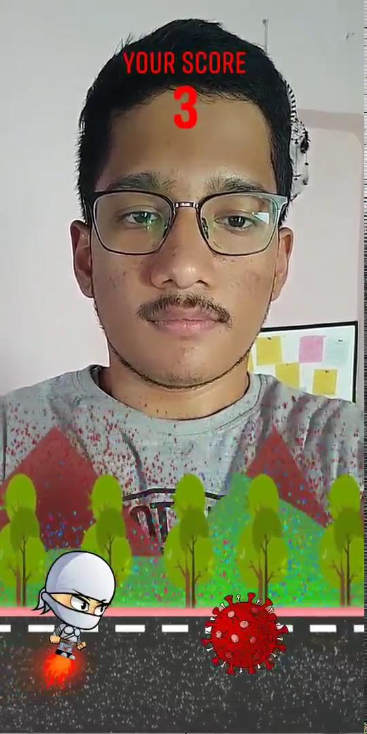
Demo Video :
About our Game Filter : Here the User will be able to blink his eye and control the Ninja so that it will be able to jump over the Corona Image models. So, as he/she plays the game their score will increase for every one jump.
Not just that, this Filter has the branding of HealthRx, and also shows roadside posters with wordings like ‘Wash your Hands’, ‘Keep a Safe Distance’, ‘ Cover and Cough’, etc…, which will bring Precautionary Awareness about the Corona-Virus Pandemic to the user.
(If you are using Microsoft PPT, then right click and click on Open Link to see the Video)

Slide 7
Benefits :
First-of-all, the user don’t want to download any new application into his/her mobile phone.
Once uploaded to SparkAR Hub, the Final generated Effect Link can be easily updated into the HealthRx App to redirect to Instagram.
People could then and there share their gameplay and Score in their Instagram and Facebook stories.
Easily Updatable to next versions.

Slide 8
Future Updates :
Can add more kind-of colliders.
Can Add music to the game features like the character jumps, colliding with the corona model.
Once uploaded to SparkAR Hub, the Final generated Effect Link can be easily updated into the HealthRx App to redirect users to Instagram to try our filter.
People could then and there share their gameplay in their stories.
Easily Updatable to next versions.

Slide 9
Thank You !

